Slide 1
Lawn Mower Simulator 2018
Home Turf: Jeff Liu, Michael Mao, Stanley Wang
Notes:
Michael Mao

Slide 2
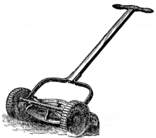
Introduction
History:
A lawn mower is a machine that uses revolving blades to cut grass to a certain height
First lawn mower invented by Edwin Budding in 1830
Still in use today
Our Game:
Player moves a mower around a lawn
Avoid boulders, use as few moves as possible
Why you should play:
Free!
Sumptuous graphics and heart-racing gameplay
3 different game modes
Free Play
Level Select
Level Creator
Notes:
Jeff

Slide 3
Data Structures/Code
Data Structures
2D Arrays
LawnMap class uses a 2D array of characters
GameWindow uses a 2D array of JLabels
Linked List
MowerStart uses a linked list of LawnMaps
GUI
Menu Window
JPanel, Buttons, BoxLayout
Game Window
JLabel, Buttons, GridLayout
Notes:
Michael

Slide 4
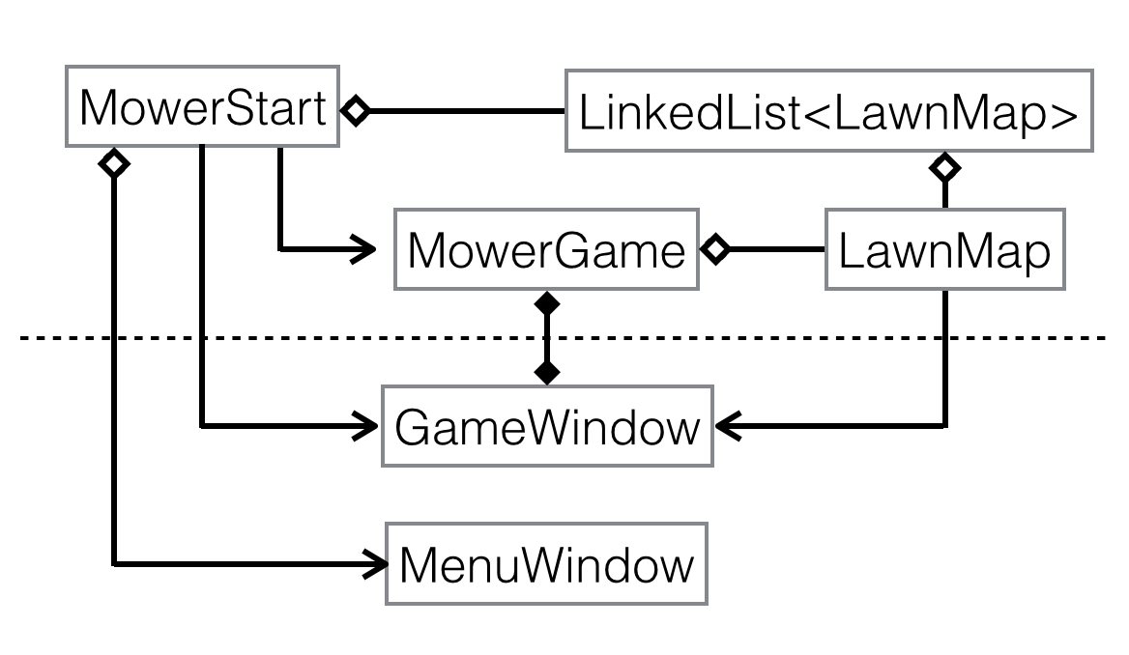
Class Diagram
Notes:
Jeff

Slide 5
Classes
LawnMap
2D character array and other information (start position, end position)
MowerStart
Starting class
Holds linked list of premade LawnMap and creates a MenuWindow
Initializes the Menu Window
MowerGame
Takes in a LawnMap as a parameter, creates a GameWindow
Keeps track of score, number of moves
Moves the mower on a copy of a 2D character array
Notes:
Jeff

Slide 6
GUI Classes
MenuWindow
GUI class with three buttons for the three game modes
Additional pop-up windows asking user for information
Level Select: user enters in an integer, the level they want to play
Creates a MowerGame after being called
GameWindow
GUI class that displays the game screen as a 2D array of JLabels
Additional labels displaying game information
Button to advance to the next level after game finishes
Notes:
Stanley

Slide 7
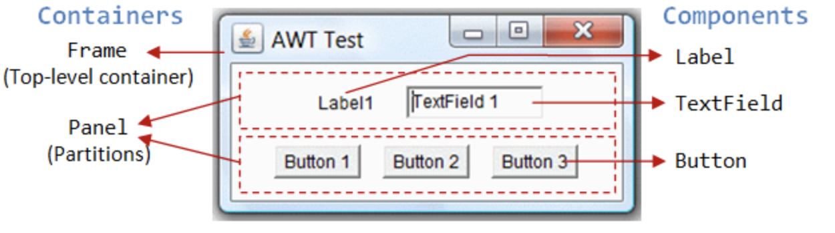
Coding Process
Learning GUI
ActionListeners and setFocusable
Image Icons, adding images
Layouts: BoxLayout, GridLayout, FlowLayout
Images resizing
Specification Changes
Got rid of extra classes, combined into the MowerStart class
Level Creator
“Next Level” button in level select mode
Display of rank after level finishes
Notes:
Stanley

Slide 8
Testing
The gameplay is the best thing since sliced bread, so we made sure to rigorously test everything to make sure no bugs hinder the immersive experience
JUnitTest
Successfully tested all of the testable methods for the classes
Testing Graphics
Tested the graphics/GUI related code by running all possible cases in the gameplay and making sure no errors occurred
Notes:
Michael Mao

Slide 9
Successes and Areas of Improvement
Learning and programming GUI from scratch
Code efficient design
Able to complete all items on project plan
Could not use Git effectively
Our repository got corrupted multiple times
Imperfect partitioning and pacing of work
Notes:
Stanley

Slide 10
Further Steps
Bolster continuity by adding a previous level button and a total score
Better graphics (background, constant tile size, animation)
More levels
GUI based level creator, level saving
Notes:
Jeff

Slide 11
DEMO

